Slide 1
Medium Access Sub Layer
Unit-III

Slide 2
OSI
Application
Presentation
Session
LOGICAL LINK sublayer
Transport
Framing
Error control
Flow control
Network
Data Link
Physical
MEDIA ACCESS sublayer
Transmission/reception of frames

Slide 3
The Medium Access Sub layer
deals with
BROADCAST NETWORKS AND THEIR PROTOCOLS
Broadcast channels are sometimes referred to as multi-access channels or random access channels.

Slide 4
Topics
Introduction
Channel Allocation problem
Multiple Access Protocols
IEEE Standard 802 for LANs
Wireless LAN
Bridges & its types.

Slide 5
Introduction
Medium Access Control (MAC) sub layer is part of Data Link layer.
In fact, it is the bottom part of DLL (interfacing with the physical layer)
This chapter deals with broadcast networks

Slide 6
The Channel Allocation Problem
Static Channel Allocation in LANs and MANs
Dynamic Channel Allocation in LANs and MANs

Slide 7
Channel Allocation problem
Static Channel Allocation in LANs and MANs
FDM & TDM
FDM:
1.The traditional way of allocating a single channel, among multiple competing users is Frequency division multiplexing(FDM).
2. If there are N users, the bandwidth is divided into N equal-sized portions, each user being assigned one portion.
3. Here each user has a private frequency band, there is no interference between users.

Slide 8
4.When there is only a small and constant number of users, each of which has heavy load of traffic, FDM is simple and efficient.
5. When number of senders is large and continuously varying, FDM presents few problems.
6.If spectrum is cut up into N regions and <N users are interested in communication, the spectrum is wasted.
7.If more than N users want to communicate, some of them will be denied permission for lack of bandwidth.
8. Assuming that the number of users be held constant at N, dividing the channel into sub-channels is inefficient.
9.The basic problem is, when some users are quiet their bandwidth is simply lost. They are not using it, and no one else is allowed to use it either.

Slide 9
Performance of static FDM from a simple queueing theory is as follows:
Assume that the mean time delay, T, for a channel of capacity C bps, with an arrival rate of λ frames/sec, each frame having a length from an exponential probability density function with 1/μ bits/frame.
With these, the arrival rate is λ frames/sec and the service rate is μC frames/sec.
From queueing theory it can be shown that for Poisson arrival and service times,
T= 1
μC - λ

Slide 10
Now let us divide the single channel into N independent sub-channels, each with capacity C/N bps. The mean input rate on each sub-channels will be λ/N.
Recomputing T we get
T_{FDM} = 1
μ(C/N)-(λ /N)
= N
μC – λ
₌ NT
The mean delay using FDM is N times worse than if all the frames were somehow magically arranged orderly in a big central queue.

Slide 11
TDM:
The same arguments that apply to FDM also apply to TDM.
Each user is statically allocated every N^{th} time slot. If a user does not use the allocated slot, it just lies fallow.
The same holds if we split up the network physically.
Note: None of the traditional static channel allocation methods work well with bursty traffic.

Slide 12
Dynamic Channel Allocation in LANs and MANs
Station Model.
Single Channel Assumption.
Collision Assumption.
(a) Continuous Time.
(b) Slotted Time.
(a) Carrier Sense.(LAN)
(b) No Carrier Sense.(SATELLITE)

Slide 13
1.Station Model:
The model consists of N independent Stations, each with a program or user that generates frames for transmission. Stations are called Terminals.
The probability of a frame being generated in an interval of length Δt is λΔt, where λ is a constant(arrival rate of new frames).
Once a frame is generated the station is blocked and does nothing until the frame has been successfully transmitted.

Slide 14
2. Single Channel Assumption:
A single channel is available for all communication.
All stations can transmit on it and all can receive from it.
3. Collision Assumption:
If two frames are transmitted simultaneously, they overlap in time and the resulting signal is garbled. This event is called a Collision.
All stations can detect collisions.
A collided frame must be transmitted again later.

Slide 15
4a. Continuous Time:
Frame transmission can begin at any instant.
There is no master clock dividing time into discrete intervals.
4b.Slotted Time:
Time is divided into slots. Frame transmission always begins at the start of a slot.
A slot can have 0,1, or more frames, corresponding to an idle slot, a successful transmission, or a collision respectively.

Slide 16
5a. Carrier Sense:
Stations can tell if the channel is in use before trying to use it.
If the channel is sensed as a busy, no station will attempt to use it until it goes idle.
5b. No Carrier Sense:
Stations cannot sense the channel before trying to use it.
They just go ahead and transmit. Only later can they determine whether the transmission was successful.

Slide 17
Multiple Access Protocols
ALOHA
Carrier Sense Multiple Access Protocols
Collision-Free Protocols
Limited-Contention Protocols
Wavelength Division Multiple Access Protocols
Wireless LAN Protocols

Slide 18
Medium Access Sub Layer
ALOHA
Aloha
Pure ALOHA (Mr. Norman Abramson in 1970s)
Slotted ALOHA (Mr.Roberts in 1972)
ALOHA system used to ground based radio broadcasting.

Slide 19
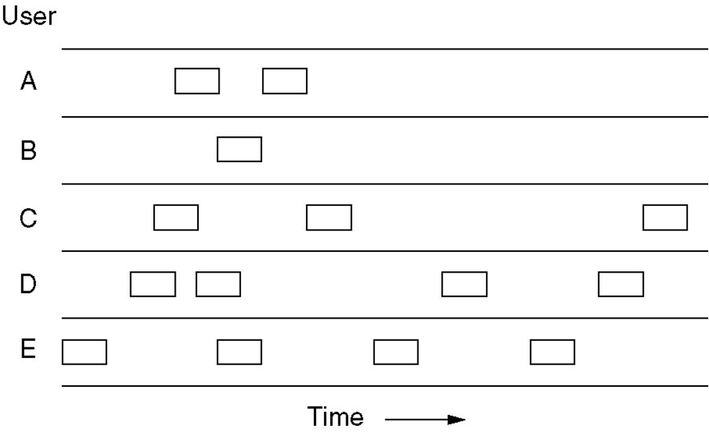
Pure ALOHA
Users transmit whenever they have data to be sent.
Fig. In pure ALOHA, frames are transmitted at completely arbitrary times

Slide 20
Systems in which multiple users share a common channel in a way that can lead to conflicts are widely known as contention system.
The frame size is fixed because the throughput of ALOHA systems is maximized.
We need to resend the frames that have been destroyed during transmission.
A collision involves two or more stations. If all these try to resend their frames after the time-out, the frames will collide again.
Pure ALOHA states that when the time-out period passes, each station waits a random amount of time before resending its frame(T_{B}).

Slide 21
Pure ALOHA has a second method to prevent congesting the channel with retransmitted frames. After a maximum no.of retransmission attempts K_{max}, a station must give up and try later.
The time-out period is equal to maximum possible round-trip propagation delay, which is twice the amount of the time required to send a frame between the two most widely separated stations(2 * T_{p} ).
The back-off time TB is a random value that depends on K.
(binary exponential back-off )

Slide 22
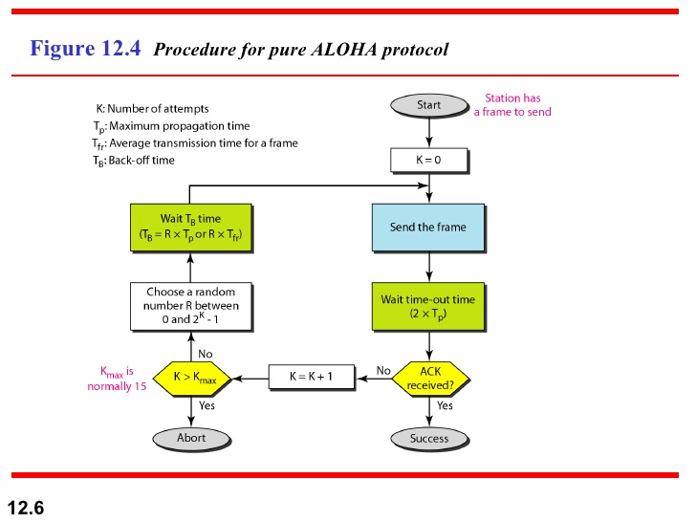

Slide 23
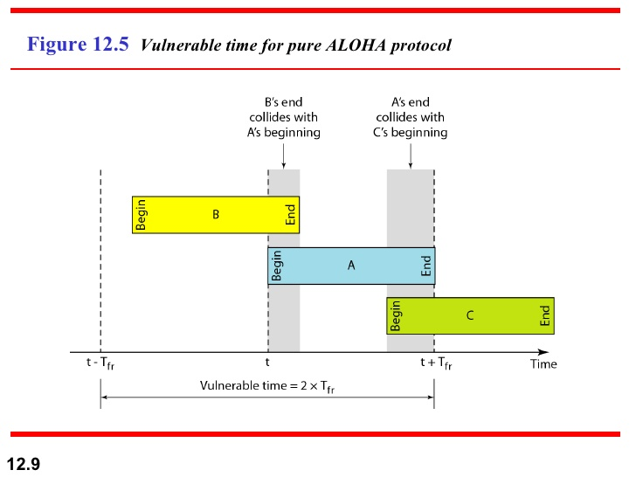

Slide 24
Pure ALOHA
Whenever two frames try to occupy the channel at the same time, there will be a collision and both will be garbled.
If the first bit of the new frame overlaps with the last bit of a frame almost finished , both frames will be totally destroyed, and both will be retransmitted later.
Throughput for pure ALOHA decreases.

Slide 25
Pure ALOHA
Disadvantage
More number of users share common channels in a way that can lead to conflicts.
More number of collisions occur.
Collision detected: stations waits a random amount of time.

Slide 26
Issues with pure aloha
Contention, collision detection, retransmission
Vulnerable period for a frame
If G is the mean number of transmission attempts (old and new) per frame time (offered load), S is the throughput per frame time, then S = Ge^{-2G} for pure ALOHA.
Maximum throughput occurs at G = 0.5 with S=1/(2e)=0.1839. I.e., maximum channel utilization is 18 percent.

Slide 27
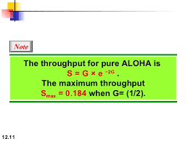
In other words, if one-half a frame is generated during one frame transmission time, then 18.4 percent of these frames reach their destination successfully.
This is an expected results because the vulnerable time is 2 times the frame transmission time.
Therefore, if a station generates only one frame in this vulnerable time, the frame will reach its destination successfully.

Slide 28
Slotted aloha
Slotted ALOHA: Divide the time into discrete intervals(slots) of Tfr s, and force the station to send only at the beginning of the time slot..
Obviously, there may be a special signal needed to synchronize the clocks at all stations.
Because a station is allowed to send only at the beginning of synchronized time slot, if a station misses this, it must wait until the beginning of next time slot.
This means that the station which started at the beginning of this slot has already finished sending its frame.
Ofcourse, there is still the possibility of collision if two stations try to send at the beginning of the same slot.

Slide 29
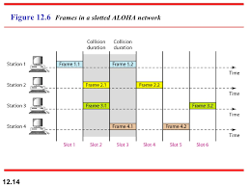

Slide 30
However, the vulnerable time is now reduced to one-half, equal to Tfr.
It can be proved that the average number of successful transmission for the slotted ALOHA is S=G * e^{-G}
Maximum throughput occurs at G=1, S=1/e or 0.368. This is twice that of pure ALOHA protocol.
In other words, if a frame is generated during one frame transmission time, then 36.8 % of these frames reach their destination successfully. This result is expected because vulnerable time is equal to the frame transmission time.
Therefore, if a station generates only one frame in this vulnerable time(and no other station generates a frame during this time), the frame will be reach its destination successfully.

Slide 31
Differences Between Pure ALOHA and Slotted ALOHA
Transmission
  In Pure ALOHA when a frame first arrives, the node immediately transmits the frame in its entirely into the Broadcast Channel.
  In Slotted ALOHA when a node has a fresh frame to send, it waits until the beginning of the next slot and transmits the entire frame in the slot.
Timing
  In Pure ALOHA Nodes can transmit frames at Random Times.
  In Slotted ALOHA Nodes can transmit frames in their respective slot boundaries only at the beginning of the Slot.

Slide 32
Differences Between Pure ALOHA and Slotted ALOHA
Synchronization
  Pure ALOHA does not require Synchronization of slots of any nodes.
  Slotted ALOHA requires synchronization between slots of nodes.
Mode of Transfer
  In Pure ALOHA the Mode of Transfer is Continuous.
  In Slotted ALOHA the mode of transfer is Discrete

Slide 33
Differences Between Pure ALOHA and Slotted ALOHA
Collission
  In Pure ALOHA If a Collision Occurs the nodes will then immediately retransmit the frame with probability P or the frame transmission time for retransmitting the frame.
  In Slotted ALOHA, if a collision occurs, the node detects the collision before the end of the slot the node retransmits its frame in each subsequent slot with probability P until the frame transmitted without a collision.
Efficiency
  In Pure ALOHA Efficiency is Half of Slotted ALOHA.
  In Slotted ALOHA efficiency is more than that of Pure ALOHA.

Slide 34
CSMA: Carrier Sense Multiple Access
Protocols in which stations listen for a carrier (i.e., transmission) and act accordingly are called carrier sense protocols.
Adv:
To minimize the chance of collision
Increases the performance.
  CSMA principle is “sense before transmit” or “listen before talk”.

Slide 35
CSMA Methods
1-persistent CSMA- constant length packets.
non-persistent CSMA- to sense the channel.
p-persistent CSMA

Slide 36
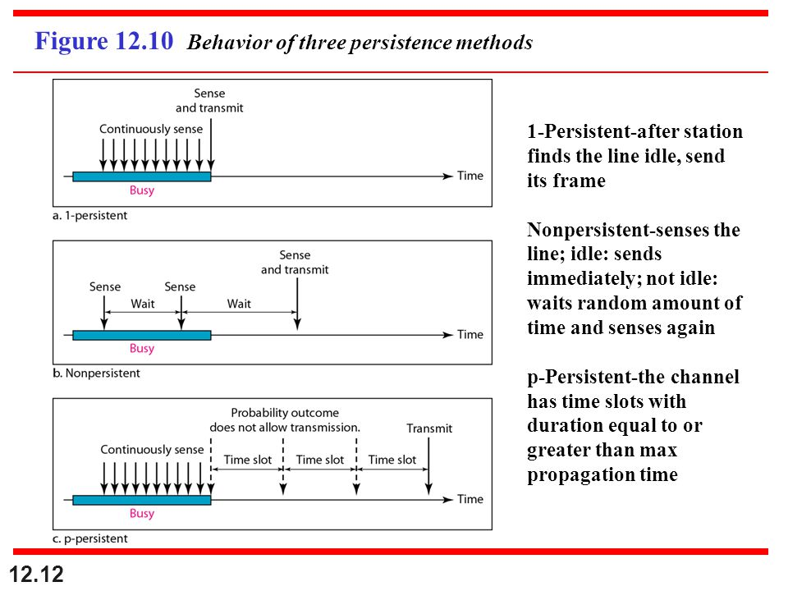

Slide 37
1-persistent
When a station has data to send, it first listens to channel to see if any one else is transmitting at that moment.
If the channel is busy, the station continuously senses the channel until it becomes idle.
When the station detects an idle channel, it transmits a frame.
If a collision occurs, the station waits a random amount of time and starts all over again.
The station transmits with a probability of 1 whenever if finds the channel idle.
This method has highest chance of collision because two or more stations may find the line idle and send their frames immediately.

Slide 38
Non-persistent CSMA
A station that has a frame to send it senses the line.
If the line is idle, it sends immediately.
If the line is not idle, it waits a random amount of time and then senses the line again.
This approach reduces the chance of collision because it is unlikely that two or more stations will wait the same amount of time and retry to send simultaneously.
This algorithm should lead to better channel utilization and longer delays than 1-persistant CSMA.

Slide 39
P-persistent CSMA
This method is used if the channel has time slots with a slot duration equal to or greater than the maximum propogation time.
It combines advantages of the other two strategies.
It reduces the chance of collision and improves efficiency.

Slide 40
P-persistent CSMA
In this method, after station finds the line idle it follows these steps:
1.With probability ‘p’, the station sends its frame.
2.With probability q=1-p, the station waits for the beginning of the next time slot and checks the line again.
a. If the line is idle, it goes to step 1.
b. If the line is busy, it acts as though a collision has occurred
and uses the back-off procedure(which discussed earlier).

Slide 41
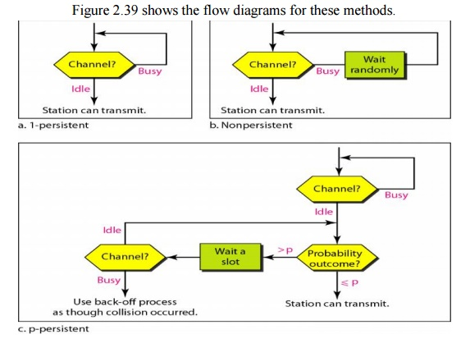

Slide 42
Carrier Sense Multiple Access with Collision Detection(CSMA/CD)
In this method, a station monitors the medium after it sends a frame to see if the transmission was successful. If so, the station is finished. If, however, there is a collision, the frame is sent again.

Slide 43
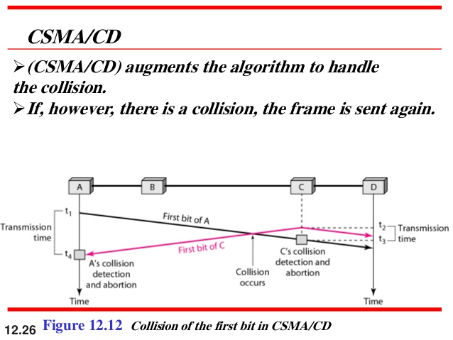

Slide 44
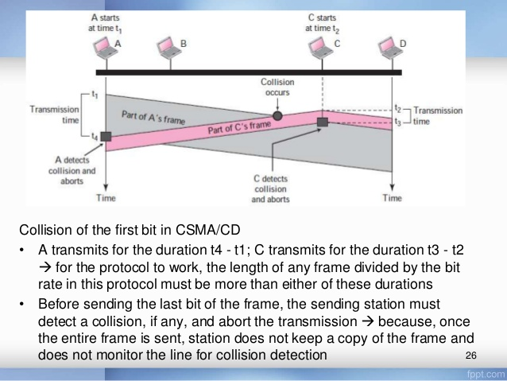

Slide 45
Minimum Frame Size
For CSMA/CD to work, we need restriction on the frame size.
Therefore, the frame transmission time Tfr must be at least two times the maximum propagation time Tp.
To understand the reason, let us think about worst-case scenario. If two stations involved in a collision are the maximum distance apart, the signal from the first takes Tp to reach the second, and the effect of the collision takes another Tp to reach the first.
So the requirement is that the first station must still be transmitting after 2Tp

Slide 46
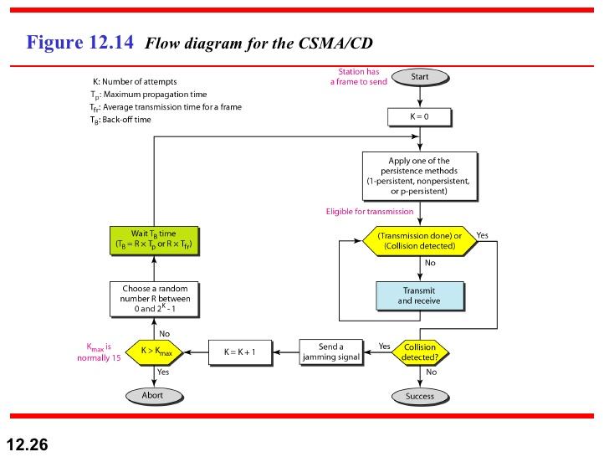

Slide 47
CSMA/CD Vs ALOHA
CSMA/CD is similar to the one for ALOHA protocol, but there are differences which as follows:
Addition of persistence methods
Frame transmission: In ALOHA, we first transmit the entire frame and then wait for an acknowledgment.
In CSMA/CD, transmission and collision is a continuous process. We do not send entire frame and then look for a collision. The station transmits and receives continuously and simultaneously.

Slide 48
Contd..
We use loop to show that transmission is a continuous process.
We constantly monitor in order to detect one of the two conditions: either transmission is finished or a collision is detected. Either event stops transmission.
When we come out of loop, if a collision has not detected, it means that the transmission is complete: the entire frame is transmitted. Otherwise, a collision has occurred.
3. Sends a short Jamming signal that enforces the collision in case other stations have not yet sensed the collision

Slide 49
Energy level in CSMA/CD
Energy
collision
Frame transmission
Frame transmission
Time
Idle

Slide 50
Throughput of CSMA/CD
The throughput of CSMA/CD is greater than that of pure or slotted ALOHA.
The maximum throughput occurs at a different value of G and is based on the persistent method and the value of p in the p-persistent approach.
For 1-persistent method the maximum throughput is around 50 % when G=1.
For non-persistent method, the maximum throughput can go up to 90 % when G is between 3 and 8.

Slide 51
Wired LANs: Ethernet
IEEE Standards
Standard Ethernet
Changes in the Standard
Fast Ethernet
Gigabit Ethernet
Data Communications, Kwangwoon University
13-<number>

Slide 52

IEEE Standards
In 1985, the Computer Society of the IEEE started a project, called Project 802, to set standards to enable intercommunication among equipment from a variety of manufacturers. Project 802 is a way of specifying functions of the physical layer and the data link layer of major LAN protocols.
Data Communications, Kwangwoon University
13-<number>

Slide 53
IEEE 802 Working Group
Active working groups | Inactive or disbanded working groups
802.1 Higher Layer LAN Protocols Working Group 802.3 Ethernet Working Group 802.11 Wireless LAN Working Group 802.15 Wireless Personal Area Network (WPAN) Working Group 802.16 Broadband Wireless Access Working Group 802.17 Resilient Packet Ring Working Group 802.18 Radio Regulatory TAG 802.19 Coexistence TAG 802.20 Mobile Broadband Wireless Access (MBWA) Working Group 802.21 Media Independent Handoff Working Group 802.22 Wireless Regional Area Networks | 802.2 Logical Link Control Working Group 802.4 Token Bus Working Group 802.5 Token Ring Working Group 802.7 Broadband Area Network Working Group 802.8 Fiber Optic TAG 802.9 Integrated Service LAN Working Group 802.10 Security Working Group 802.12 Demand Priority Working Group 802.14 Cable Modem Working Group
Data Communications, Kwangwoon University
13-<number>

Slide 54

Logical Link Control (LLC)
Framing: LLC defines a protocol data unit (PDU) that is similar to that of HDLC
To provide flow and error control for the upper-layer protocols that actually demand these services.
It provides one single data link control protocol for all IEEE LANs.
Data Communications, Kwangwoon University
13-<number>

Slide 55
Medium Access Control(MAC)
IEEE Project 802 has created a sub-layer called MAC that defines specific access methods for each LAN.
In contrast to LLC sub-layer, the MAC sub layer contains a number of distinct modules; each defines the access method and the framing format specific to the LAN protocol.
Physical layer
The physical layer is dependent on the implementation and the type of physical media used.
Data Communications, Kwangwoon University
13-<number>

Slide 56


MAC Sublayer
Preamble: Alternate 0’s and 1’s that alerts the receiving system to the coming frame and enables it to synchronize its input timing.
Data Communications, Kwangwoon University
13-<number>

Slide 57


Addressing
Ethernet address in hexadecimal notation
The least significant bit of the first byte defines the type of address.
If the bit is 0, the address is unicast; otherwise, it is multicast
The broadcast destination address is a special case of the multicast address in which all bits are 1s
Data Communications, Kwangwoon University
13-<number>

Slide 58

Standard Ethernet
The original Ethernet was created in 1976 at Xerox’s Palo Alto Research Center (PARC). Since then, it has gone through four generations
Data Communications, Kwangwoon University
13-<number>

Slide 59


Physical Layer: Ethernet
Data Communications, Kwangwoon University
13-<number>

Slide 60


10Base5: Thick Ethernet
10Base2: Thin Ethernet
Data Communications, Kwangwoon University
13-<number>

Slide 61


10BaseT: Twisted-Pair Ethernet
10Base-F: Fiber Ethernet
Data Communications, Kwangwoon University
13-<number>

Slide 62

Summary of Standard Ethernet
Data Communications, Kwangwoon University
13-<number>

Slide 63


Changes in the Standard
Bridged Ethernet: Raising bandwidth and separating collision domains
Data Communications, Kwangwoon University
13-<number>

Slide 64

Changes in the Standard
Switched Ethernet: N-port bridge
Data Communications, Kwangwoon University
13-<number>

Slide 65

Changes in the Standard
Full-duplex (switched) Ethernet: no need for CSMA/CD
Data Communications, Kwangwoon University
13-<number>

Slide 66
Fast Ethernet
Under the name of IEEE 802.3u
  Upgrade the data rate to 100 Mbps
  Make it compatible with Standard Ethernet
  Keep the same 48-bit address and the same frame format
  Keep the same min. and max. frame length
MAC Sublayer
  CSMA/CD for the half-duplex approach
  No need for CSMA/CD for full-duplex Fast Ethernet
Autonegotiation: allow two devices to negotiate the mode or data rate of operation
Data Communications, Kwangwoon University
13-<number>

Slide 67


Fast Ethernet: Physical Layer
Topology
Implementation
Data Communications, Kwangwoon University
13-<number>

Slide 68

Summary of Fast Ethernet
Data Communications, Kwangwoon University
13-<number>

Slide 69
Gigabit Ethernet
Under the name of IEEE 802.3z
  Upgrade the data rate to 1 Gbps
  Make it compatible with Standard or Fast Ethernet
  Keep the same 48-bit address and the same frame format
  Keep the same min. and max. frame length
  Support autonegotiation as defined in Fast Ethernet
MAC Sublayer
  Most of all implmentations follows full-duplex approach
  In the full-duplex mode of Gigabit Ethernet, there is no collision; the maximum length of the cable is determined by the signal attenuation in the cable.
Half-duplex mode (very rare)
  Traditional: 0.512 μs (25m)
  Carrier Extension: 512 bytes (4096 bits) min. length
  Frame bursting to improve the inefficiency of carrier extension
Data Communications, Kwangwoon University
13-<number>

Slide 70

Gigabit Ethernet: Physical Layer
Topology
Data Communications, Kwangwoon University
13-<number>

Slide 71

Gigabit Ethernet: Physical Layer
Implementation
Data Communications, Kwangwoon University
13-<number>

Slide 72

Gigabit Ethernet: Summary
Data Communications, Kwangwoon University
13-<number>

Slide 73

Ten-Gigabit Ethernet
Under the name of IEEE 802.3ae
  Upgrade the data rate to 10 Gbps
  Make it compatible with Standard, Fast, and Giga Ethernet
  Keep the same 48-bit address and the same frame format
  Keep the same min. and max. frame length
  Allow the interconnection of existing LANs into a MAN or WAN
  Make Ethernet compatible with Frame Relay and ATM
MAC Sublayer: Only in full-duplex mode → no CSMA/CD
Data Communications, Kwangwoon University
13-<number>

Slide 74
Wireless
Local Area Networks

Slide 75
Wireless Local Area Networks
The proliferation of laptop computers and other mobile devices (PDAs and cell phones) created an obvious application level demand for wireless local area networking.
Companies jumped in, quickly developing incompatible wireless products in the 1990’s.
Industry decided to entrust standardization to IEEE committee that dealt with wired LANS – namely, the IEEE 802 committee!!

Slide 76
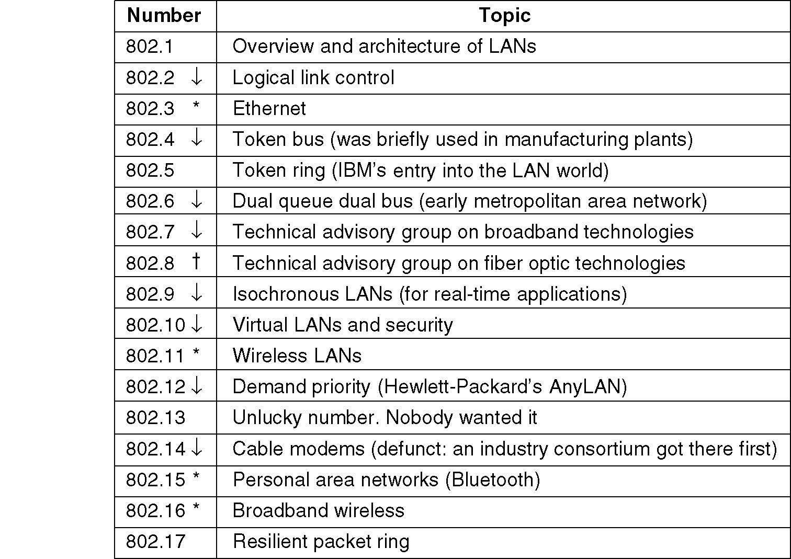
IEEE 802 Standards Working Groups
Figure 1-38. The important ones are marked with *. The ones marked with ↓ are hibernating. The one marked with † gave up.

Slide 77
Categories of Wireless Networks
Base Station :: all communication through an access point {note hub topology}. Other nodes can be fixed or mobile.
Infrastructure Wireless :: base station network is connected to the wired Internet.
Ad hoc Wireless :: wireless nodes communicate directly with one another.

Slide 78
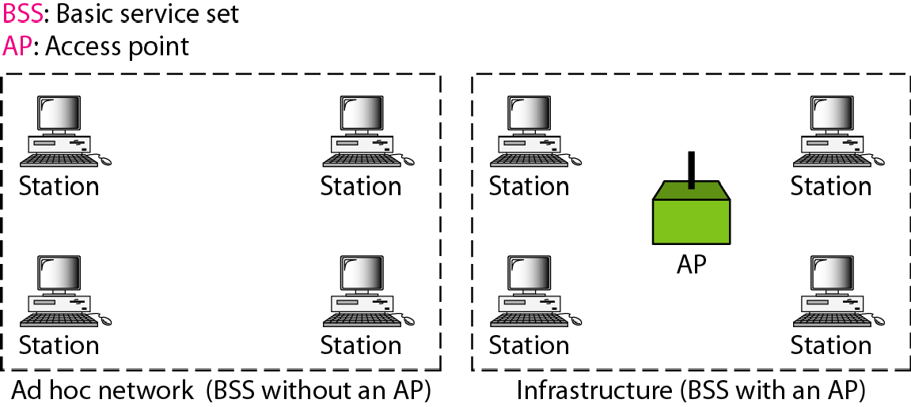
Basic service sets (BSSs)
14.<number>

Slide 79
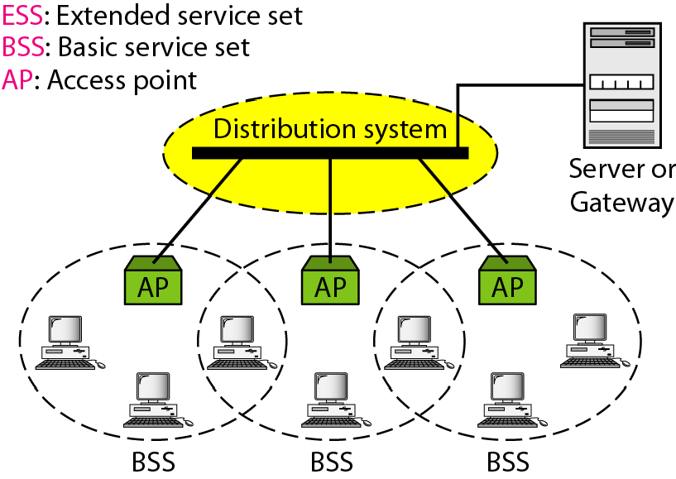
Figure 14.2 Extended service sets (ESSs)
14.<number>

Slide 80
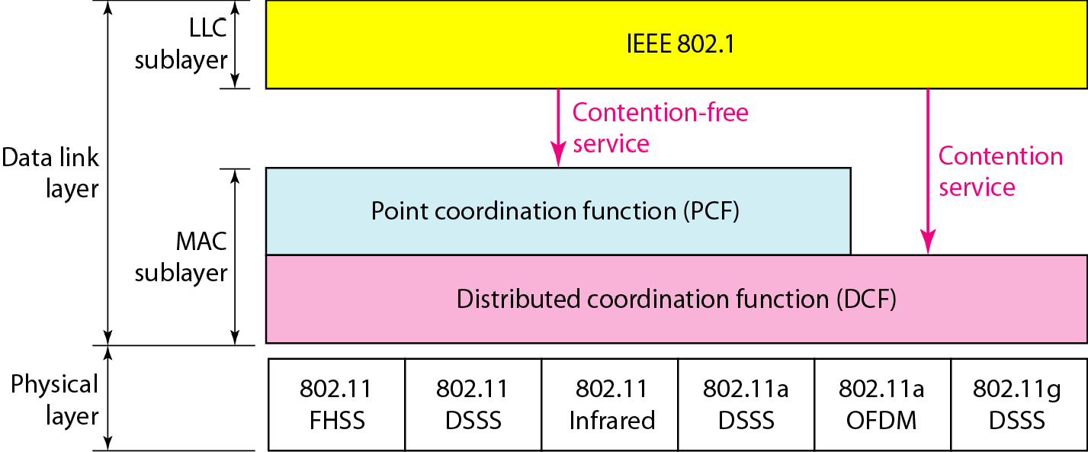
MAC layers in IEEE 802.11 standard
14.<number>

Slide 81
Distribute Coordination Function (DCF)
Uses CSMA/ CA (CSMA with Collision Avoidance).
  Uses both physical and virtual carrier sensing.
  Two methods are supported:
based on MACAW(Multiple Access with Collision Avoidance for Wireless) with virtual carrier sensing.
1-persistent physical carrier sensing.

Slide 82

CSMA/CA flowchart
14.<number>

Slide 83
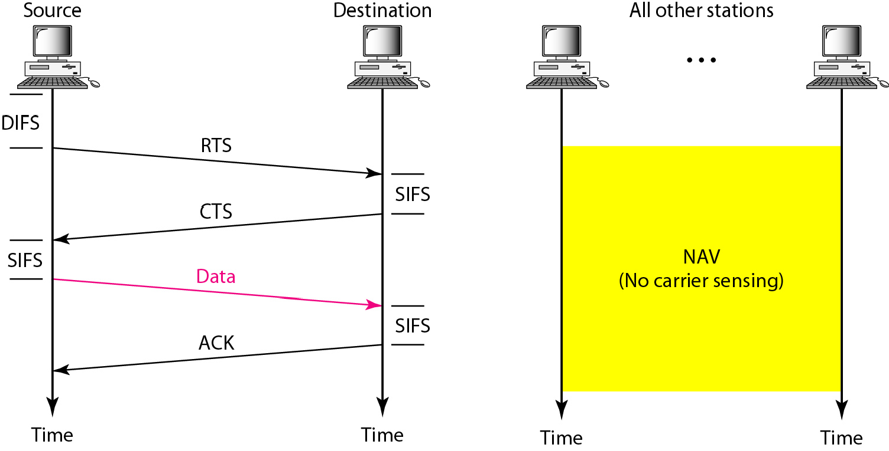
Figure 14.5 CSMA/CA and NAV
14.<number>

Slide 84
Point Coordinated Function (PCF)
PCF uses a base station to poll other stations to see if they have frames to send.
No collisions occur.
Base station sends beacon frame periodically.
Base station can tell another station to sleep to save on batteries and base stations holds frames for sleeping station.

Slide 85
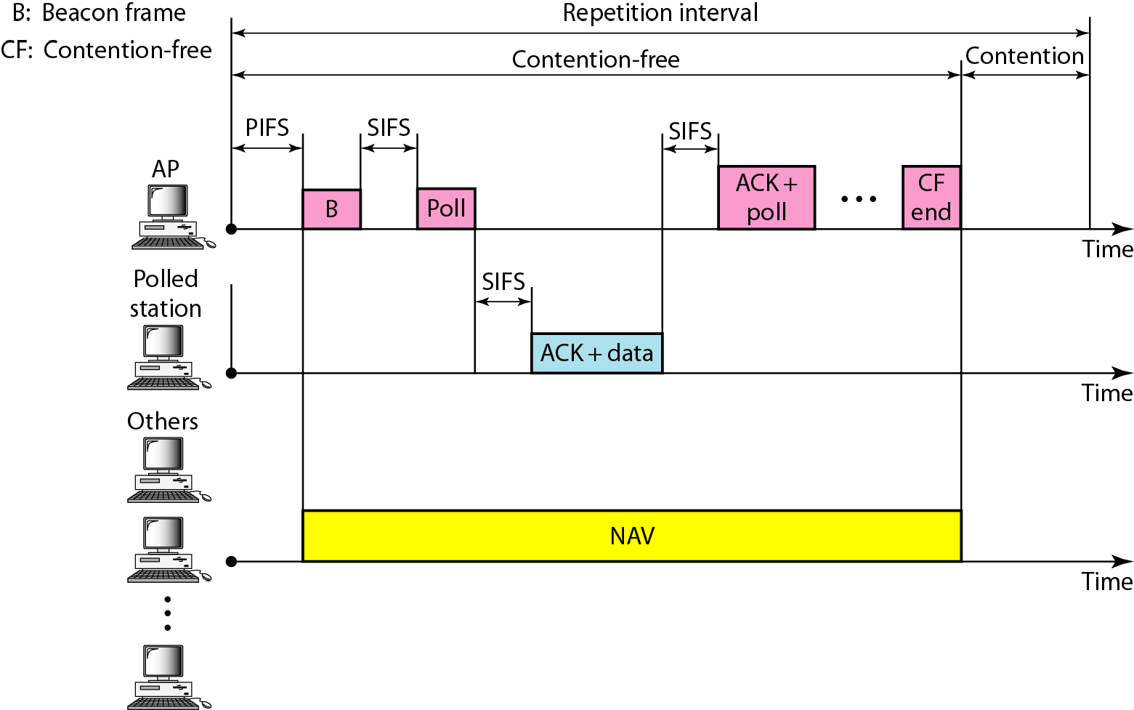
Example of repetition interval
14.<number>

Slide 86

Figure 14.7 Frame format
14.<number>

Slide 87
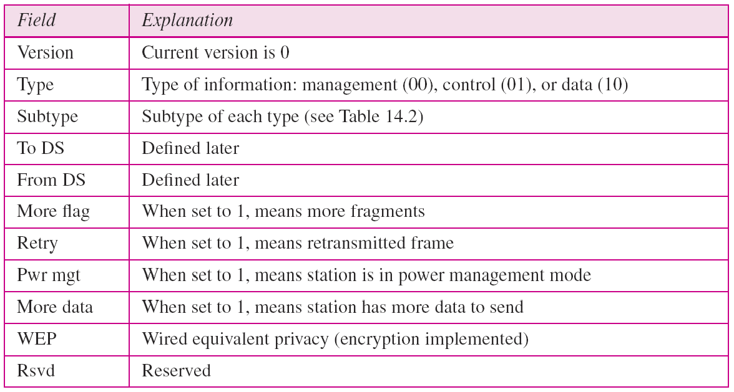
Table 14.1 Subfields in FC field
14.<number>

Slide 88
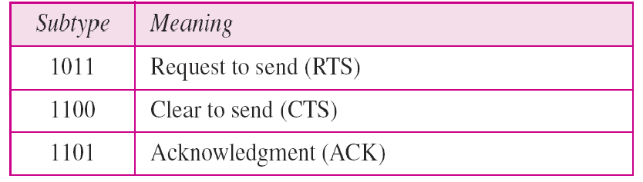
Table 14.2 Values of subfields in control frames
14.<number>

Slide 89
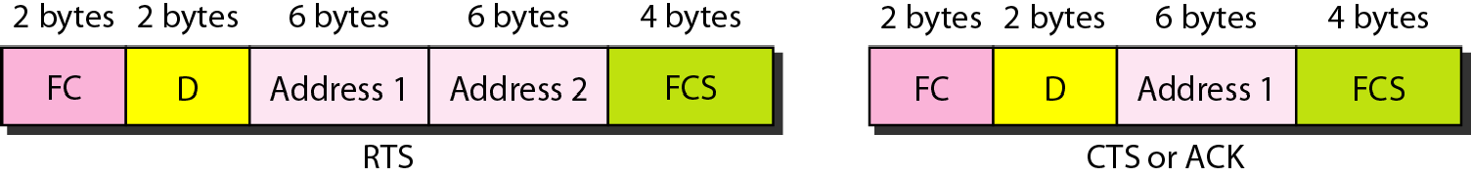
Control frames
14.<number>

Slide 90
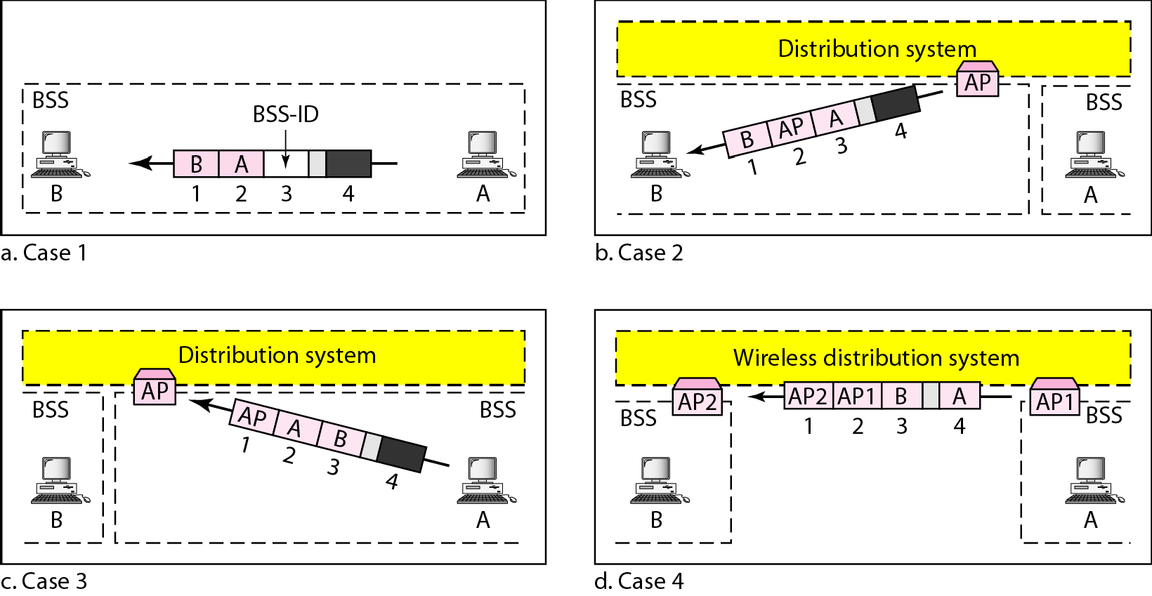
Addressing mechanisms
14.<number>

Slide 91
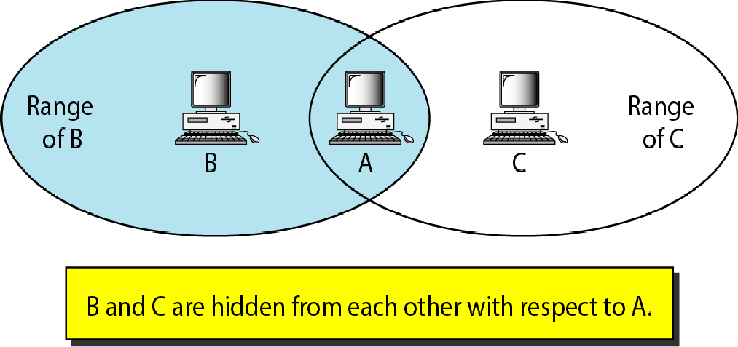
Hidden station problem
14.<number>

Slide 92

Note
The CTS frame in CSMA/CA handshake can prevent collision from
a hidden station.
14.<number>

Slide 93
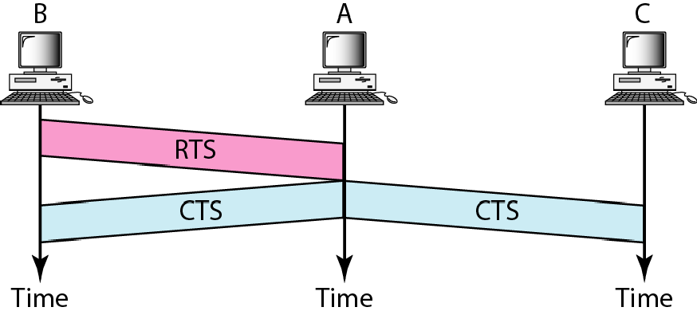
Use of handshaking to prevent hidden station problem
14.<number>

Slide 94
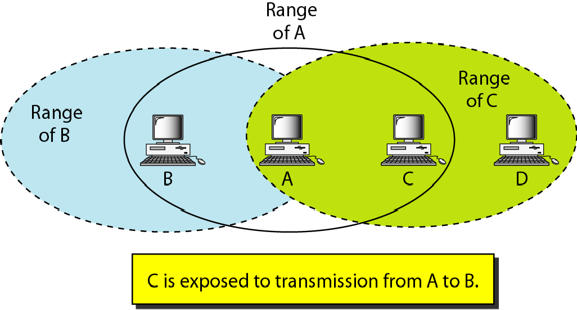
Exposed station problem
14.<number>

Slide 95
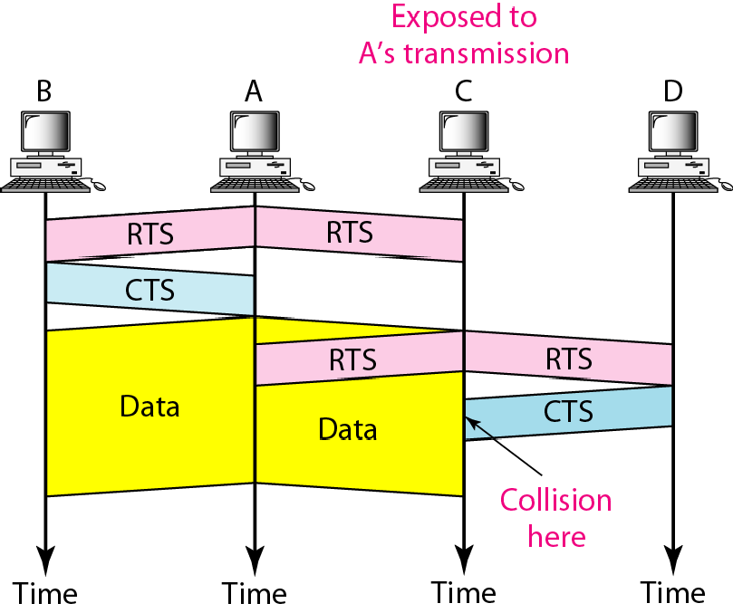
Use of handshaking in exposed station problem
14.<number>

Slide 96
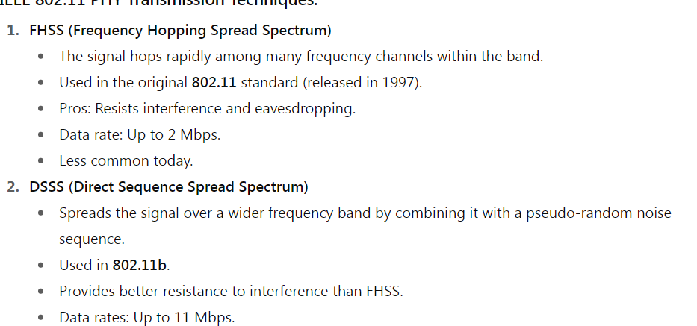
Wireless Physical Layer

Slide 97
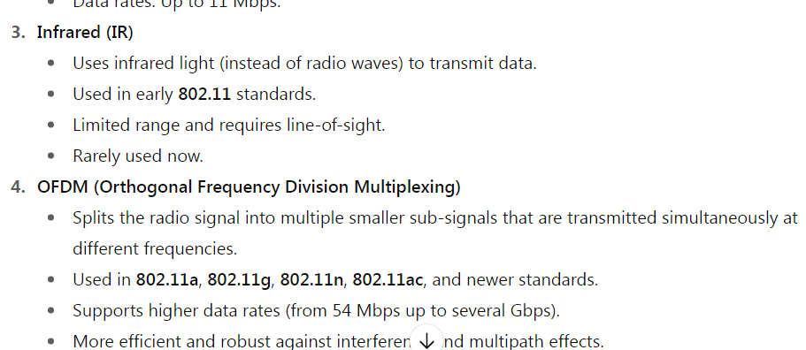
Wireless Physical Layer

Slide 98
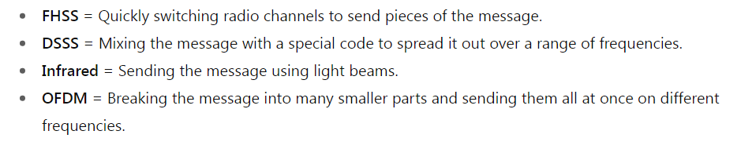
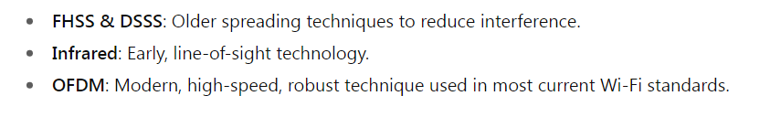
Wireless Physical Layer

Slide 99
Bridges
Means to interconnect individual LANs
Operate at the data link layer
Reasons for bridges:
(1)autonomous divisions (2) different buildings (3) logical grouping (4) physical distance (5) Reliability (6) Security( due to Promiscuous mode)
Issues in bridging different LANs:
(i) Different frame format (ii) different data rates (iii) Timers at higher layers (iv) different maximum frame lengths

Slide 100
Bridges
Multiple LANS can be connected by devices called bridges.
If a bridge is added or detected from the system, reconfiguration of the stations is unnecessary(It means that bridges should be fully transparent).

Slide 101

Bridges
Bridge
A
C
LANs can be connected by devices called bridges, which operate in the data link layer. Bridges do not examine the network layer header.

Slide 102
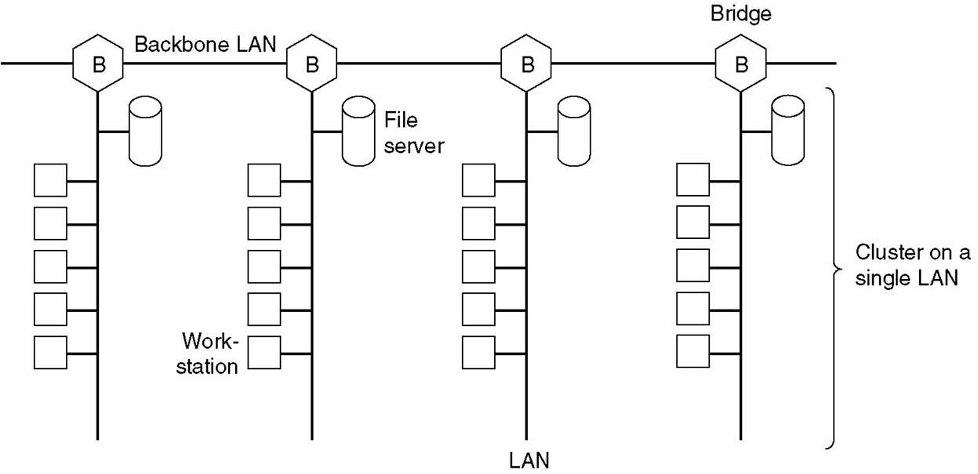
Fig. Multiple LANs connected by a backbone to handle a total load
higher than the capacity of a single LAN.

Slide 103
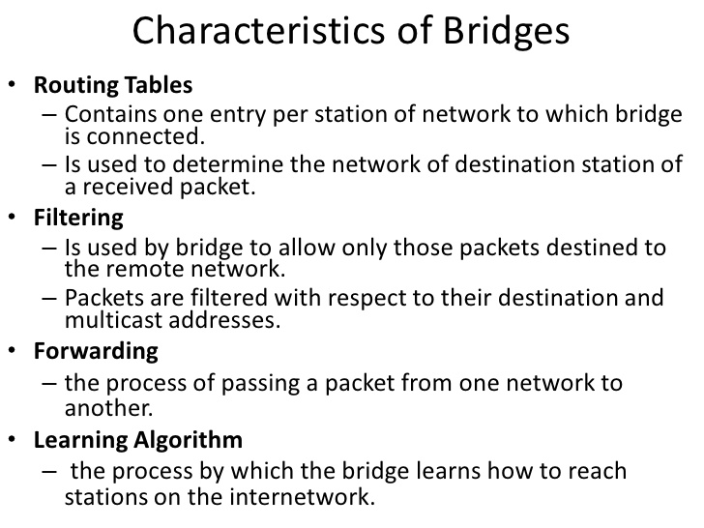

Slide 104
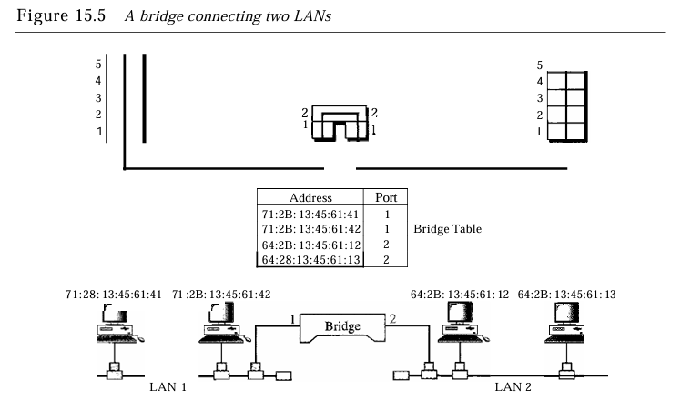

Slide 105
TRANSPARENT BRIDGES
When a frame arrives, a bridge must decide whether to discard or forward it.
Each bridge contains hash tables specifying that destination address.
The table can list each possible destination and tell which output line it belongs on.
When the bridges are first plugged in. all the hash tables are empty.
Few days back they are using flooding algorithm for bridges.
Every incoming frame for an unknown destination is output on all the LANs to which the bridge is connected except the one it arrived on.
The algorithm used by the transparent bridges is Backward-learning ,based on source address bridges can tell which machine is accessible on which LAN.

Slide 106
3 rules for forwarding the frame.
If destination and source LANs are the same discard the frame.
If destination and source LANs are different , forward the frame.
If the destination LAN is unknown, use flooding.

Slide 107
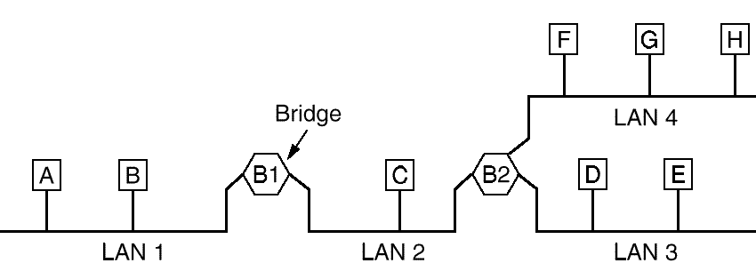
Transparent Bridges
Plug and play bridge
When a frame arrives, a bridge must decide whether to discard or forward it, and if the latter, on which LAN to put the frame. The decision is made by looking up the destination address in a big (hash) table inside the bridge.

Slide 108
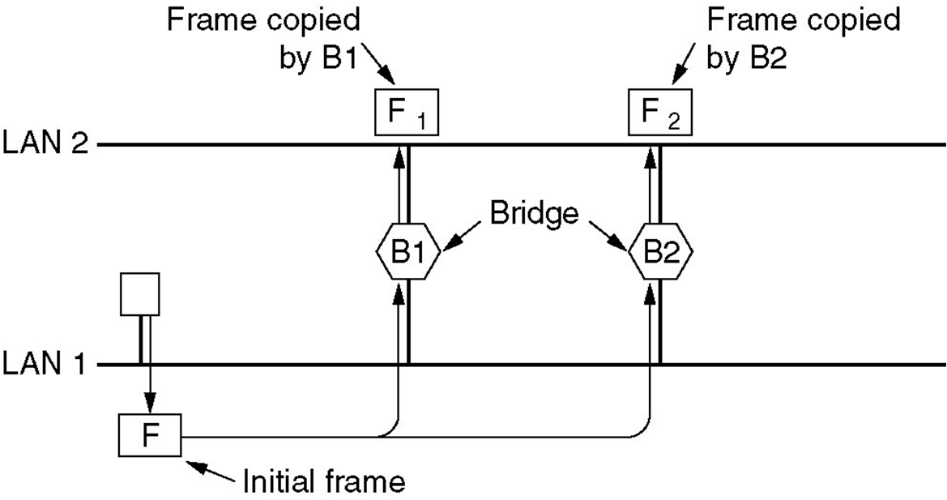
Two parallel transparent bridges

Slide 109
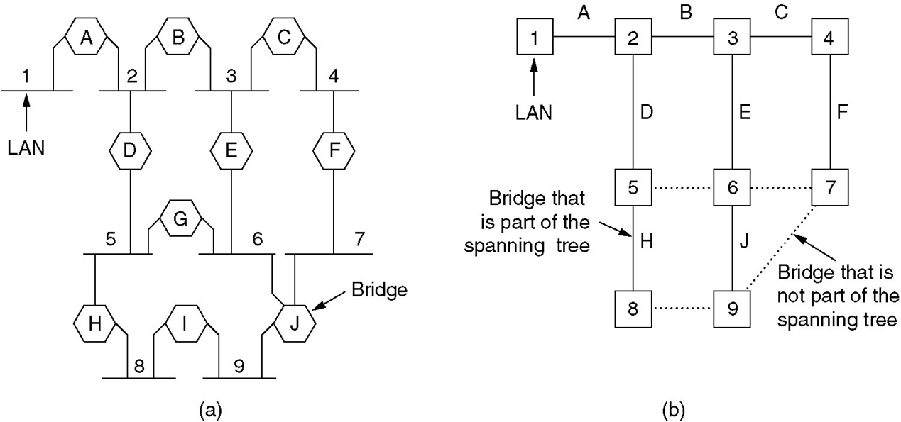
SPANNING TREE BRIDGES
(a) Interconnected LANs. (b) A spanning tree covering the LANs. The dotted lines are not part of the spanning tree.

Slide 110
Spanning Tree Bridges
To build the spanning tree, first the bridges have to choose one bridge to be the root of the tree. They make this choice by having each one broadcast its serial number, installed by the manufacturer, and guaranteed to be unique worldwide. The bridge with the lowest serial number becomes the root. Next, a tree of shortest paths from the root to every bridge and LAN is constructed.

Slide 111
Source routing Bridges
Source routing assumes that the sender of each frame knows whether or not the destination is on its own LAN. When sending a frame to a different LAN, the source machine sets the high-order bit of the destination address to 1, to mark it. Furthermore, it includes in the frame header the exact path that the frame will follow.

Slide 112
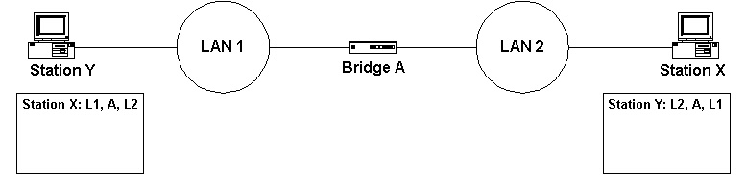

Slide 113
Implicit in the design of source routing bridge is that every machine in the internetwork knows, or can find, the best path to every other machine. How these routes are discovered is an important part of the source routing bridge.
The basic idea is that if a destination is unknown, the source issues a broadcast frame asking where it is. This discovery frame is forwarded by every bridge so that it reaches every LAN on the internetwork. When the reply comes back, the bridges record their identity in it, so that the original sender can see the exact route taken and ultimately choose the best route.

Slide 114
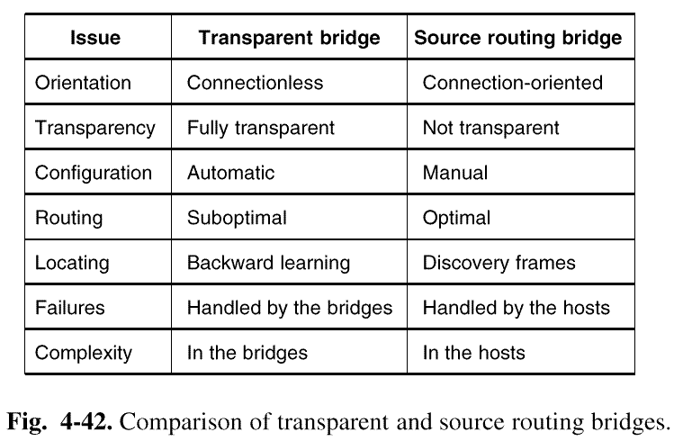
4.4.4 Comparison of 802 Bridges

Slide 115
Remote Bridges
Used when individual LANs are far apart
In this case bridges on each LAN are connected via point-to-point links

Slide 116
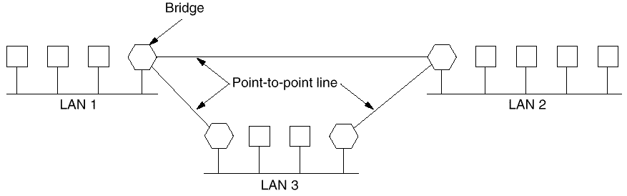
Remote Bridges
Point to point protocol used between bridges( 2 options):
Choose some standard point-to-point data link protocol i.e, PPP, putting complete MAC frames in the payload field (best if all LANs are identical)
2. Strip off the MAC header and trailer at source bridge, put what is left in the payload field of PPP. A new MAC header and trailer can be generated at the destination bridge(can not catch errors caused by bad bridge memory)

